Slide 1
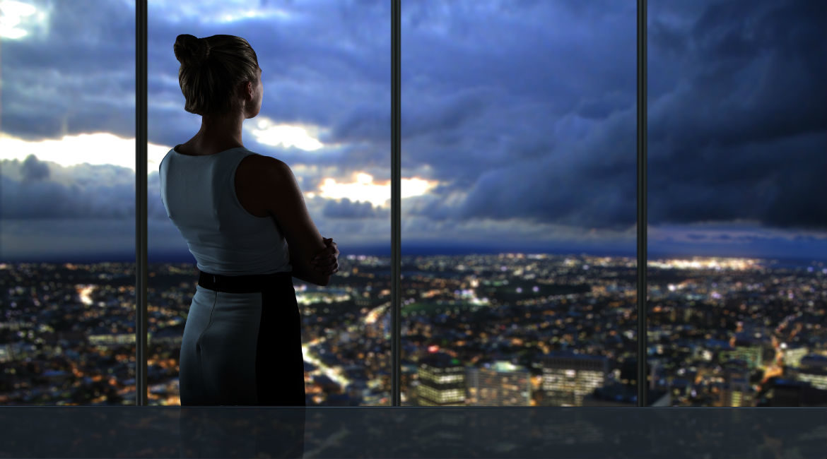
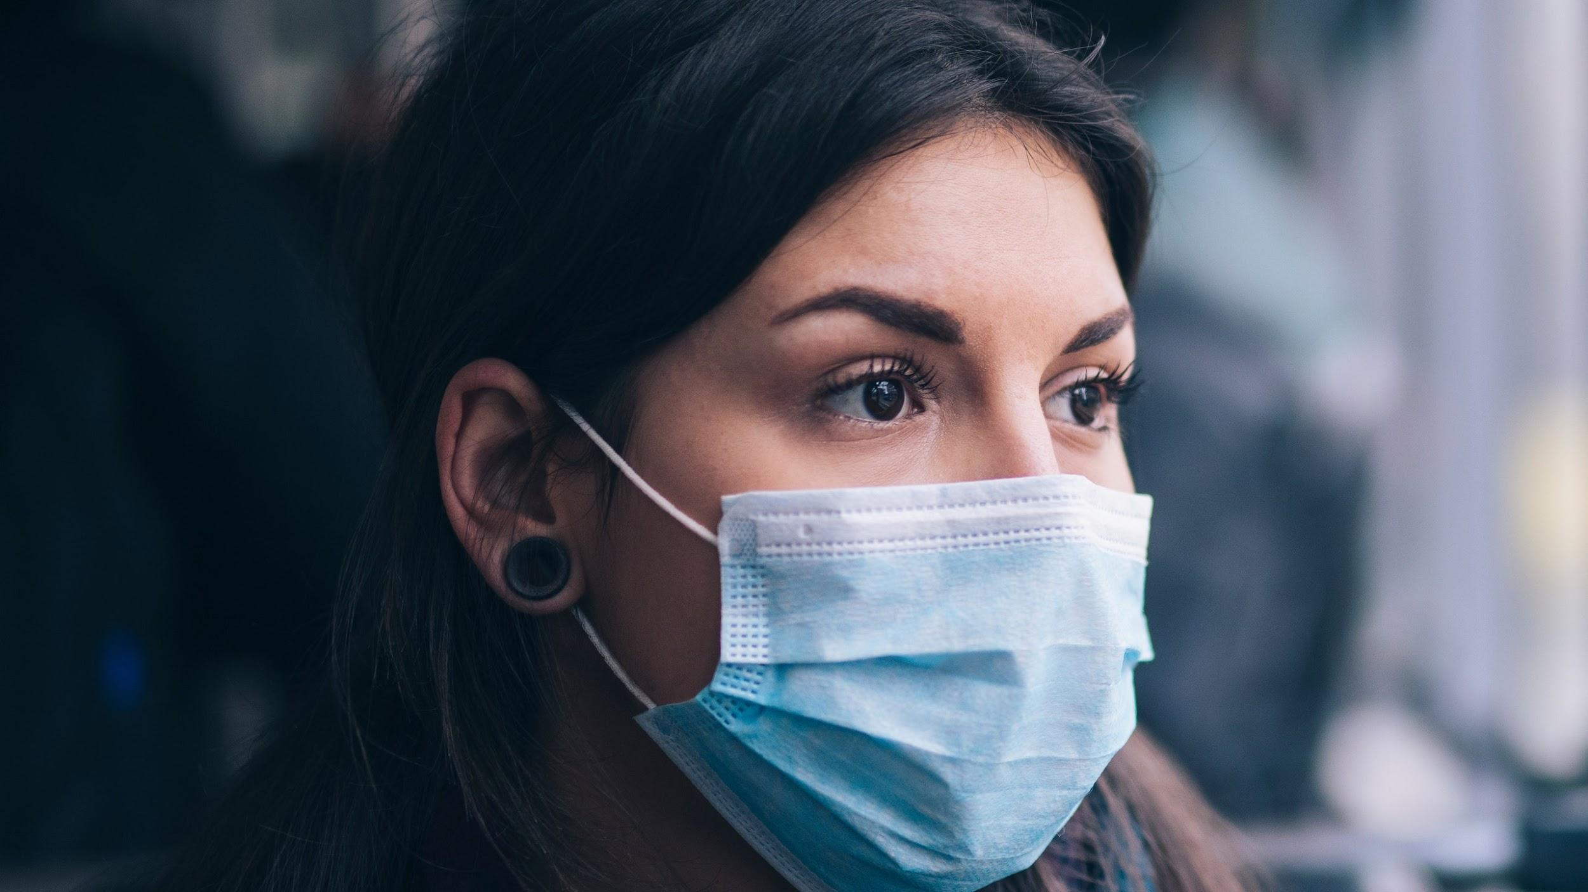
Face Mask Compliance
Compliance Leads to Containment
Mitchell, Cathy, Yuchen, Jessie

Slide 2
Agenda
Objectives
01
05
Image Classification Model
Comparable Products
02
06
Model Comparison
Data
03
07
Workflow Design
Object Detection Model
04
08
Demo

Slide 3
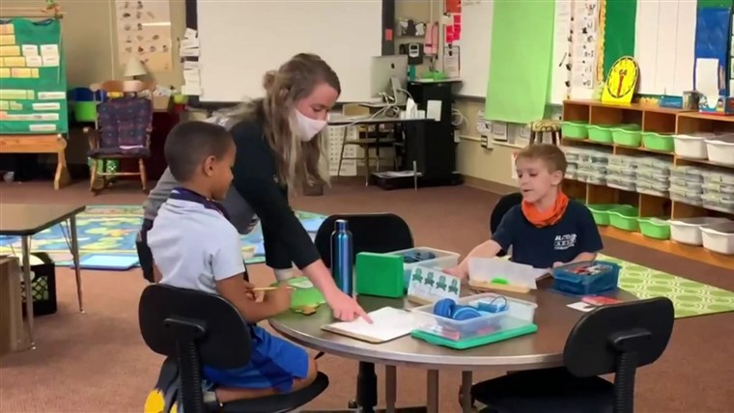
Objectives
As the country opens up, customers are wary to return back to locations they used to frequent due to hesitation on other’s compliance to Covid mandates. A transparent, standardized compliance score for locations would alleviate concerns.
Empower schools and branch owners to understand how their managed locations are performing with COVID rules as they continue to open up.
Accountability of adherence to government issued rules/guidelines

Slide 4
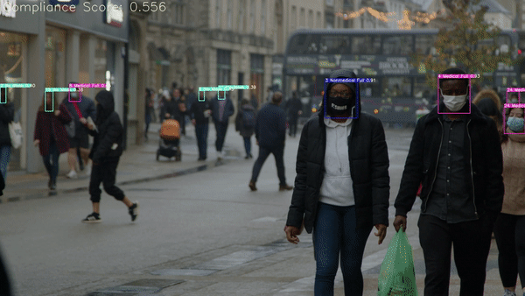
Deliverable
Average compliance: 100%
% of individuals compliant: 100%
1 Medical mask
Person 2.0 is compliant
Person 1.0 is compliant
Person 4.0 is compliant
Person 3.0 is compliant
Person 5.0 is not compliant
Person 6.0 is not compliant
Person 8.0 is compliant
Person 12.0 is compliant
Person 11.0 is not compliant
Person 19.0 is not compliant
Person 20.0 is not compliant
Person 24.0 is compliant
Person 23.0 is compliant
Person 26.0 is not compliant
overall compliance 0.5714285714285714
Results saved to runs/detect/exp
Done. (48.425s)

Slide 5
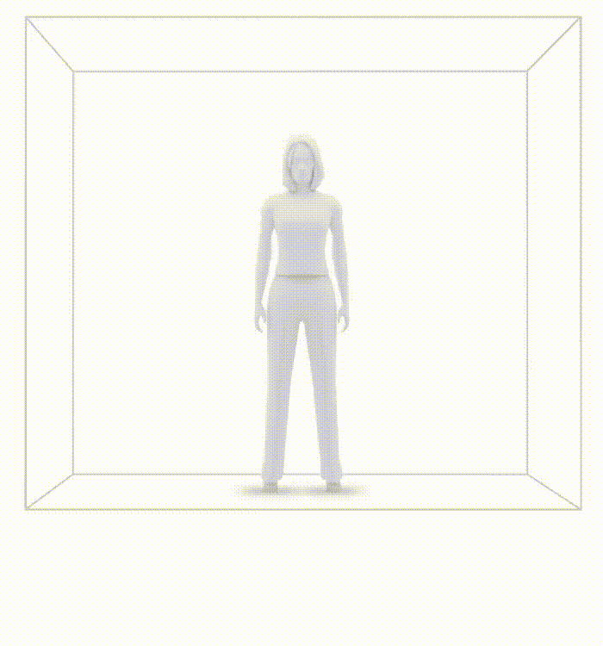
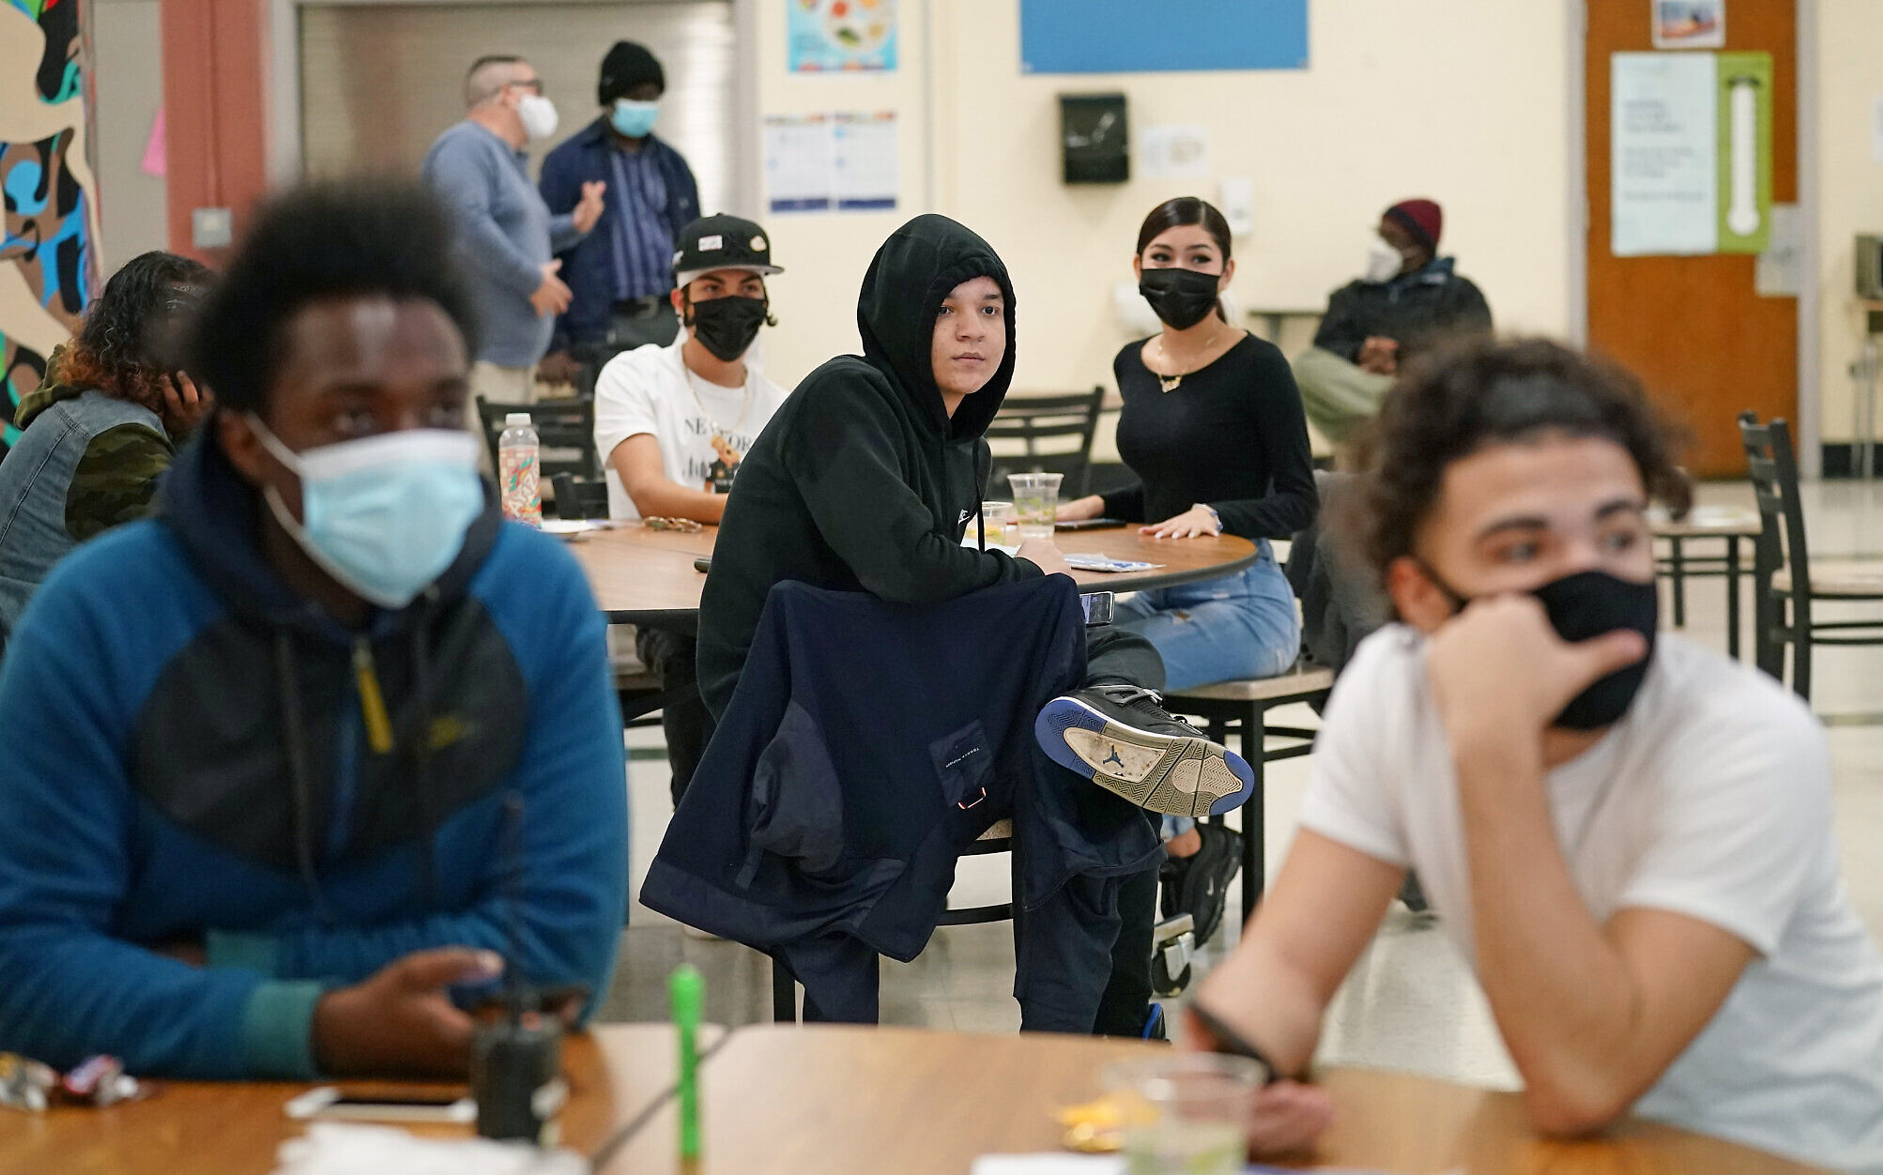
Special Use Case - Reopening Schools
Not only is he spreading it more if he was a carrier, but he is also at an exponentially higher risk of contracting the virus by opting out of wearing a face mask.
Accumulation of floating aerosol particles within an hour without a mask in poor ventilation

Slide 6
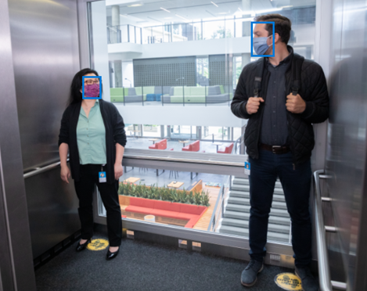
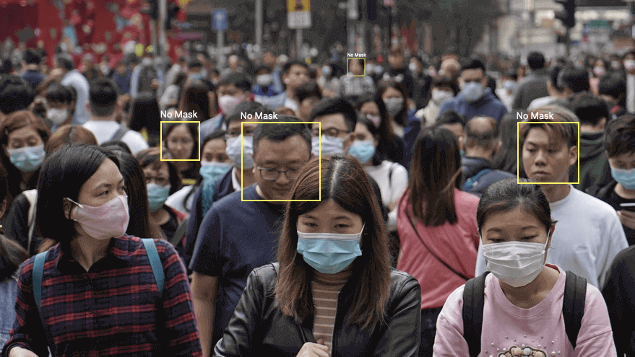
Comparable Products
MSFT Face Mask Detection Public Preview via Azure Cognitive Services
Face Mask non-compliance detection offered as a product

Slide 7
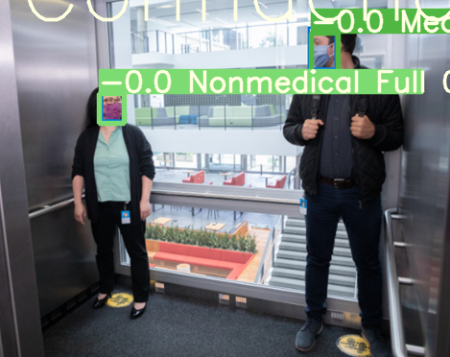
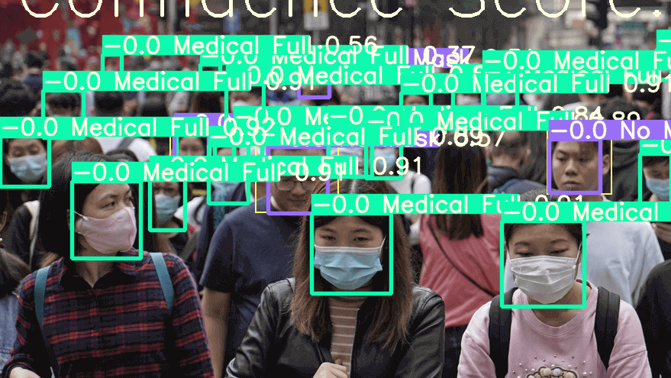
Comparable Products
Competitor’s Face Mask Detection
Our Face Mask Detection

Slide 8
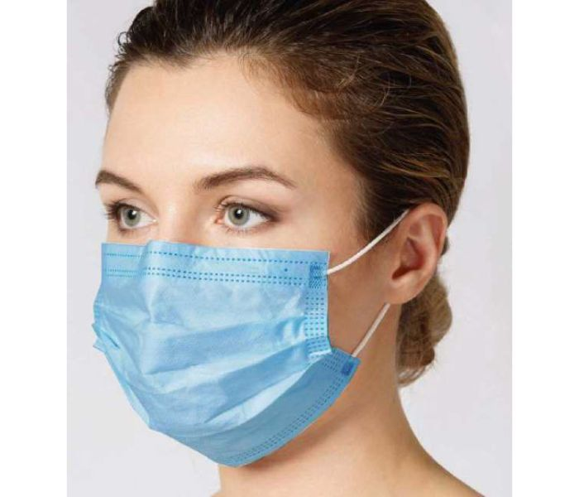
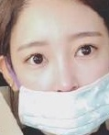
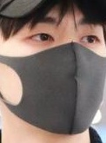
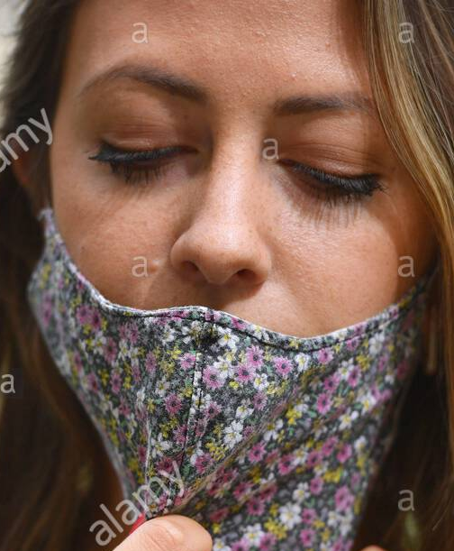
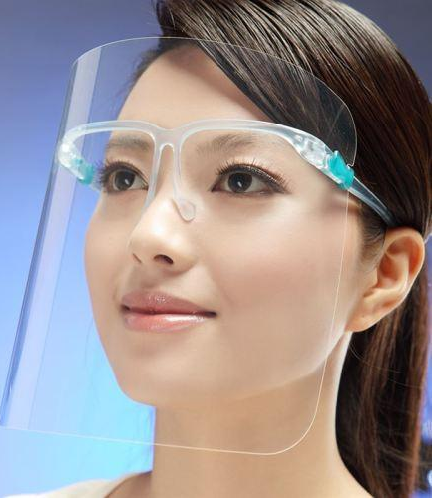
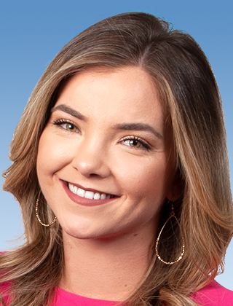
Output Categories & Prepared Dataset
Mask Type | If Worn Correctly | Examples | Size of Data
Medical Masks | Correct |  | 306
 | Incorrect |  | 180
Non-medical Masks | Correct |  | 440
 | Incorrect |  | 179
Face Shields |  |  | 123
No Mask |  |  | 157
Notes:
Data source:
Kaggle dataset
China celebrity dataset
Google searched data
Online shopping images

Slide 9
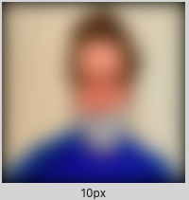
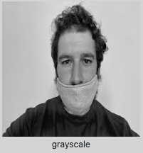
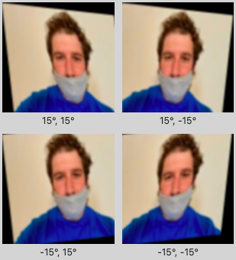
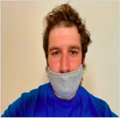
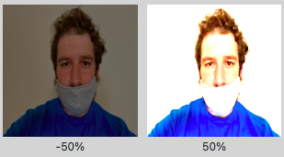
Data Augmentation
Blur
Grey Scale
Shear
Brightness

Slide 10
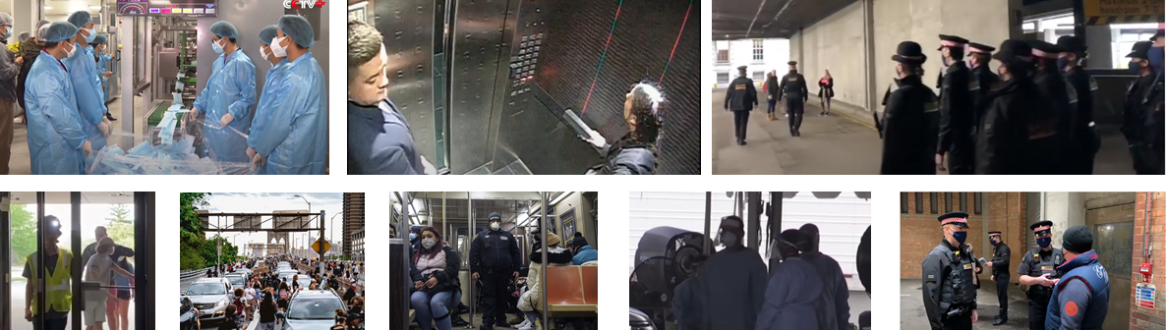

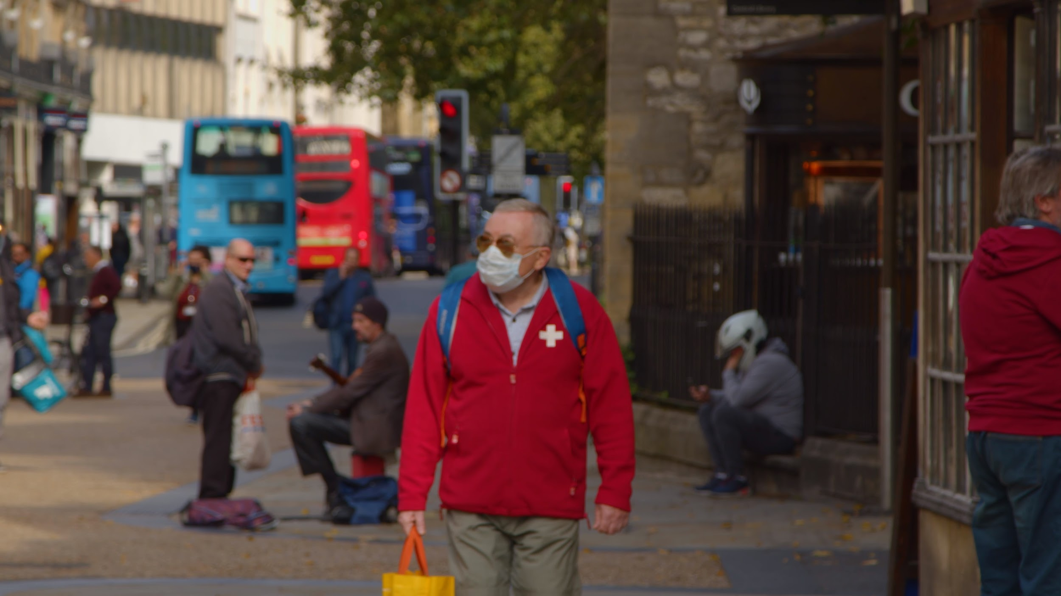
Additions to Data
Completed two rounds of additions to data, totaling 220 images consisting of:
Selfies taken by friends, and still photos found online
Screenshots of surveillance footage and other videos
These images provided our models with additional examples of:
Diverse geographies
Varied lighting
Typically crowded areas, e.g. subways, gyms, airports, restaurants, stores, elevators
More angles and rotations

Slide 11
Modeling Overview
Object Detection
Image Classification
Selected Model | YOLOv5x | MobileNetV3
Additional Layers | Deep Sort Layer | Face Detection Layer Deep Sort Layer
Hypothesis | May perform better for distant faces on video | Potential to benefit from existing face detection models, or perform better on clearer images

Slide 12
Object Detection Workflow
Input
Annotated images
6 categories
Data Augmentation
Deep Sort Layer
Track number of unique individuals for individual compliance score calculation
Detect Mask
YOLOv5x
Input
Video
Facemask Detector Model
Output
Marked Video
Compliance score

Slide 13
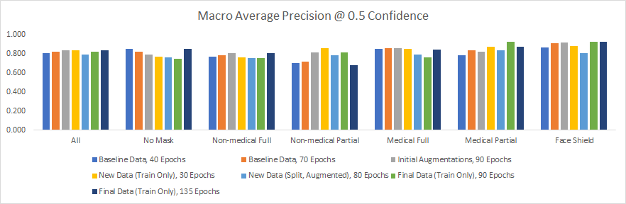
YOLOv5x Model Performance
Highest score was 0.842 on latest model, but penultimate model was selected for implementation
Performance was better assessed via manual video analysis, rather than automated evaluation

Slide 14
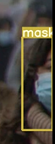
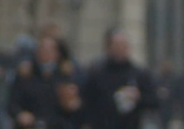
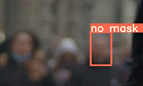
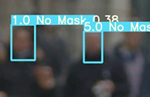
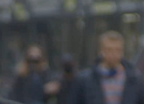
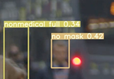
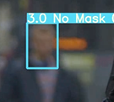
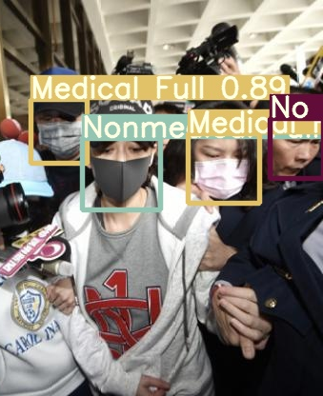
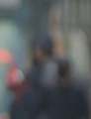
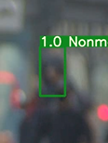
Model Evolution on Sample Video
All Models
Baseline Model
With First Data Update
With Final Data & Deep Sort

Slide 15
Image Classification Workflow
Input
Annotated images
6 categories
Data Augmentation
Deep Sort Layer
Face Detection Layer
aizoo
Mask Detection Layer
MobileNetV3
Data preprocessing step
Selected pre-trained model aizoo
Classifies face images into 6 classes
Trained from prepared dataset (face only)
Input
Video
Facemask Detector Model
Output
Marked Video
Compliance score

Slide 16
MobileNetV3 Model Performance
Train on final data (augmented, w/ additions)
64 batch size, 140 epochs
Model Evolution
Label | Precision | Recall | F1 Score | Support
No mask | 0.94 | 0.97 | 0.95 | 129
Non-medical full | 0.71 | 0.87 | 0.79 | 138
Non-medical partial | 0.67 | 0.62 | 0.64 | 44
Medical full | 0.90 | 0.82 | 0.85 | 207
Medical partial | 0.83 | 0.68 | 0.74 | 78
Face shield | 0.82 | 0.85 | 0.84 | 23
Total |  |  | 0.83 | 619
Layer | Improvement | Result
Face Detection | Base model facenet-pytorch | Detected non-face objects; missed black faces
 | Fixed image format issue from video to image (BGR vs. RGB) | Better but only detected close faces
 | Explored face detection models and selected aizoo | Better w/ some far and blurred faces detected
Mask Detection | Base model | Accuracy: 0.68
 | Augmentation + additions of data | Accuracy: 0.76
 | Optimized batch size and epoch # | Accuracy: 0.83

Slide 17
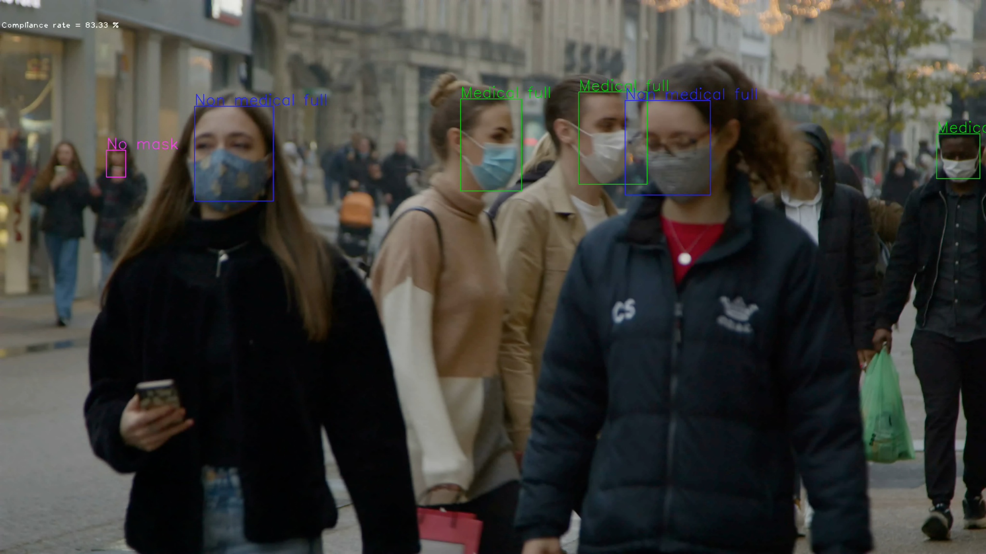
Result on Video
Link to video

Slide 18
Comparison of Model Results
Object Detection
Image Classification
Model used | YOLOv5x | MobileNetV3 + aizoo
Face detection | Similar performance in close faces YOLOv5x performs better for blurred farther faces
Mask detection | Accuracy 0.84 for both steps Errors focused on medical vs non-medical and partial vs full | Accuracy 0.83 for mask detection step Errors more widespread in all cases
Overall performance | YOLOv5x performs better overall, especially on more complex videos

Slide 19
Demo

Slide 20
Member Contributions
Common Tasks
Project Team
Mitchell
Yuchen
Jessie
Cathy
Collect and label/annotate images for the dataset. Help improve the models built, regularly give and receive feedback
YOLO Model Training and tuning, Feature Ideation and Data set enhancement, Deep Sort Model Integration
Image Classification model selection, training and tuning; Face detection model selection and integration; deep sort model integration. Data collection
Data Collection, Model Hosting Platform, Flask WebSite Hosting
YOLO model training and tuning, analysis/evaluation, feature ideation, data collection and enhancement

Slide 21
Appendix

Slide 22
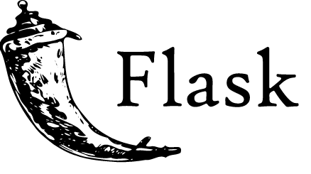


Final Product
User Interface
(HTML)
Upload input
Pass to model
Cloud hosting
Python flask application
Result Displayed
& Available For Download
Return output
Send result to user

Slide 23
Comparison of Model Results - Mask detection
Object Detection (YOLOv5)
Image Classification (MobileNetV3)
 | No mask | Non-med full | Non-med partial | Medical full | Medical partial | Face shield
No mask |  | 3% | 7% | 4% | 3%
Non-med full | 3% |  | 7% | 15%
Non-med partial |  | 3% |  |  | 3% | 3%
Medical full | 1% | 15% |  |  | 10%
Medical partial | 1% |  | 13% | 6%
Face shield |  |  |  | 1%
 | No mask | Non-med full | Non-med partial | Medical full | Medical partial | Face shield
No mask |  | 3% | 3% | 3% | 3% | 1%
Non-med full | 3% |  | 4% | 24% | 7% | 2%
Non-med partial | 1% | 4% |  | 3% | 3%
Medical full | 3% | 9% | 2% |  | 7%
Medical partial | 1% | 1% | 3% | 4% |  | 1%
Face shield | 1% | 1% | 1% | 1%

Slide 24
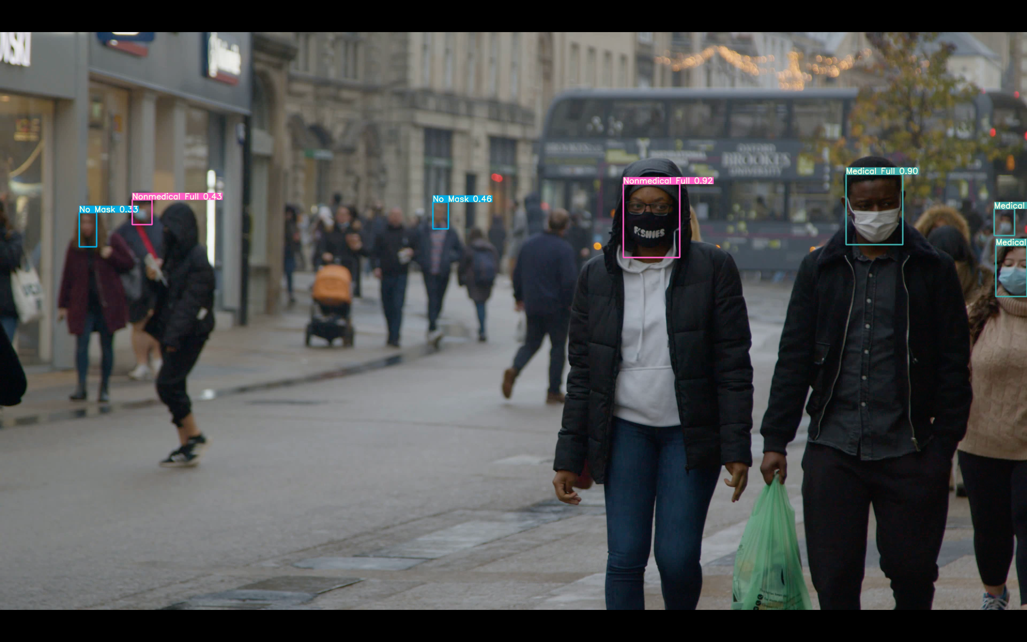
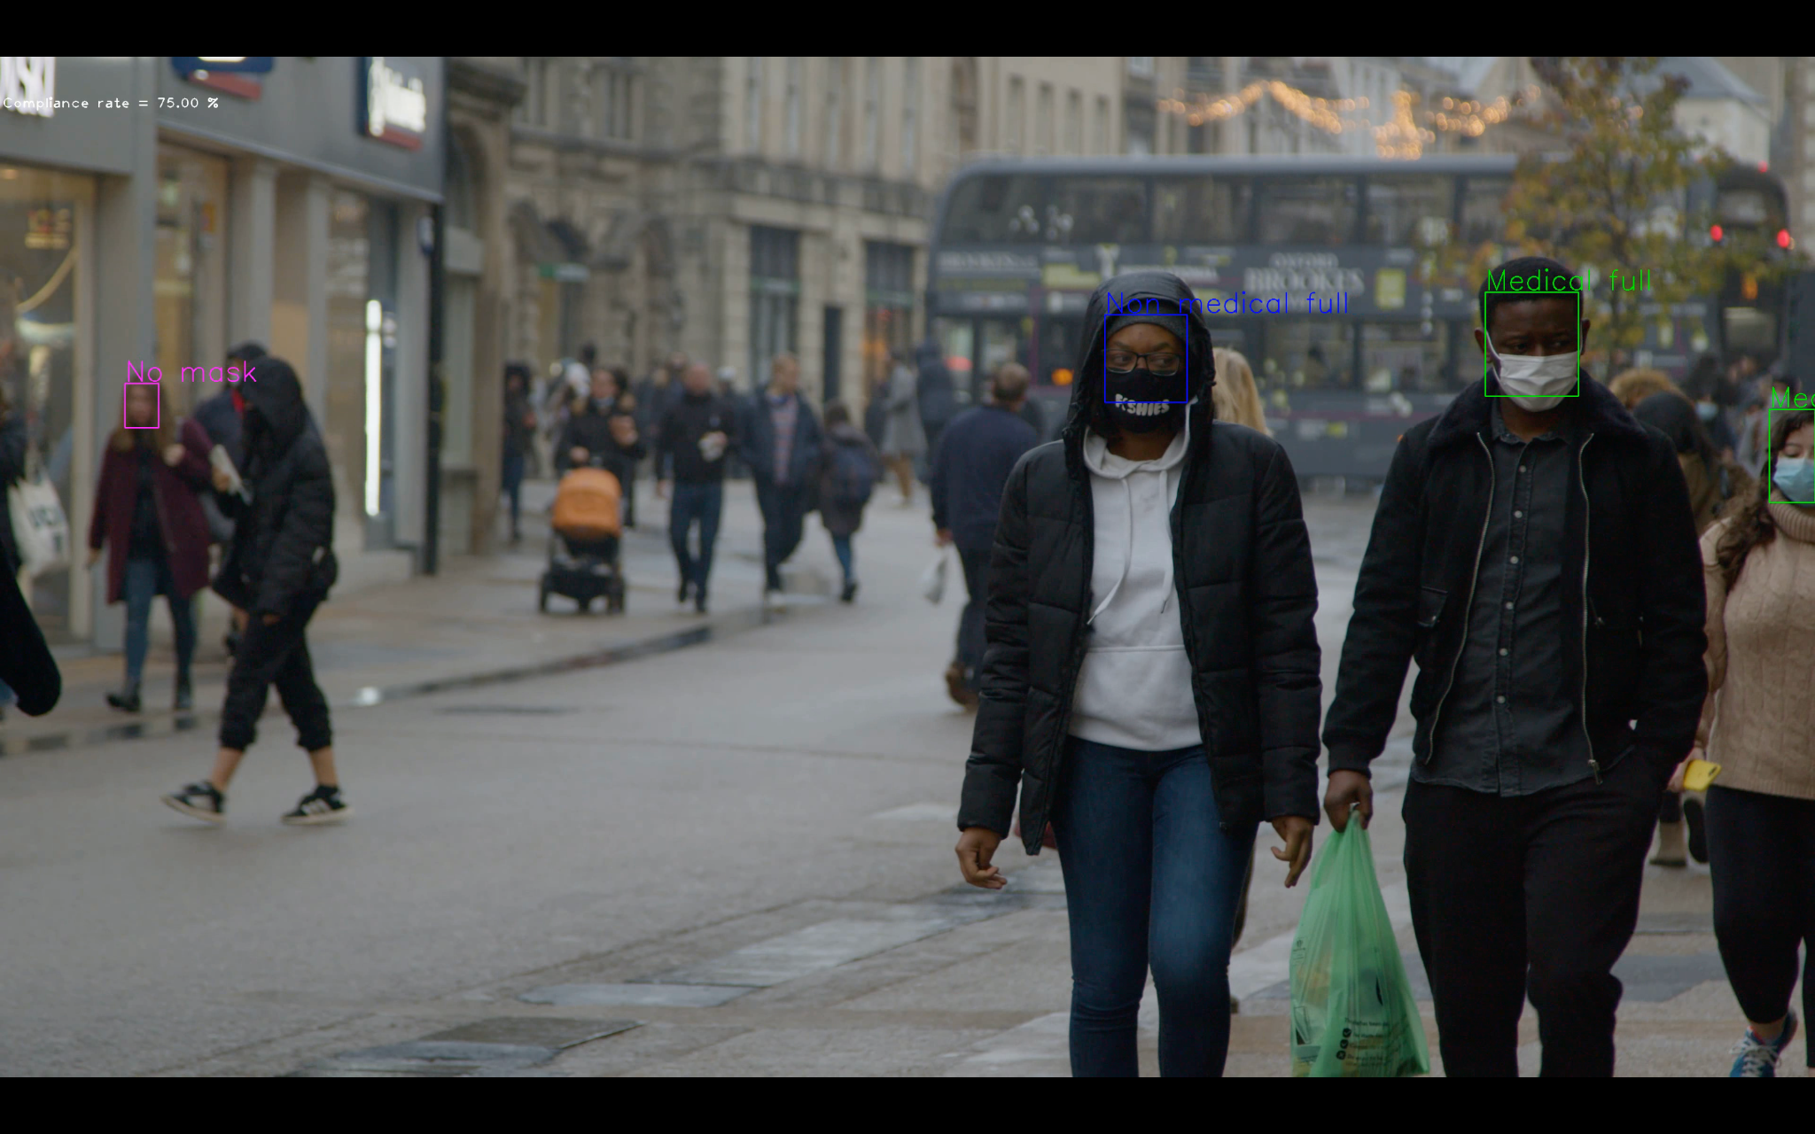
Comparison of Model Results - Face detection
Object Detection (YOLOv5)
Image Classification (aizoo)

